Slide 1
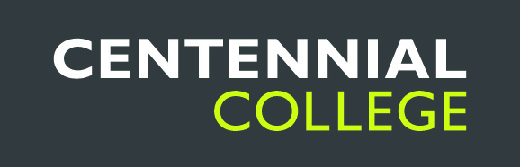
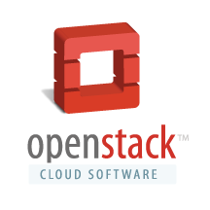
School of Engineering Technology and Applied Science
Cloud Computing
Reza Dibaj

Slide 2
Contents:
Cloud Computing
SaaS
PaaS
IaaS
Comparing Traditional and Modern Approaches in Cloud Computing
OpenStack
What is OpenStack?
Why Switching to OpenStack?
OpenStack’s Components

Slide 3
Cloud Computing
Cloud Computing is where software applications, data storage, and processing capacity are accessed over the internet.
Cloud Computing Building Blocks
SaaS (Software as a Service)
PaaS (Platform as a Service)
IaaS (Infrastructure as a Service)
All these building blocks allows users to run applications and store data online; however, each offers a different level of user flexibility and control.

Slide 4
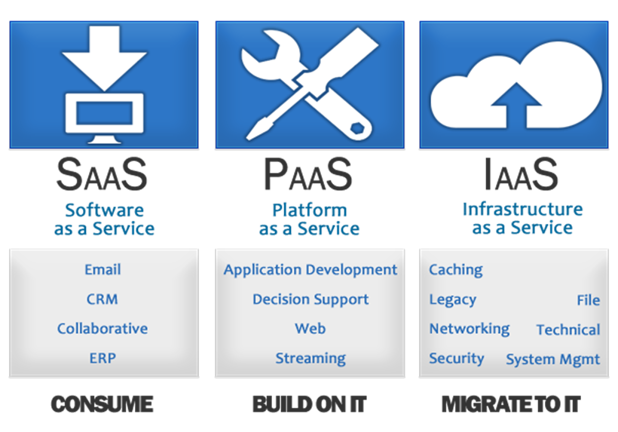
Building Blocks of Cloud Computing:
SaaS (Software as a Service)
Allows users to run existing online applications
PaaS (Platform as a Service)
Allows users to create their own cloud applications using supplier-specific tools and language
IaaS (Infrastructure as a Service)
Allows users to run any applications they please on cloud hardware of their own choice

Slide 5
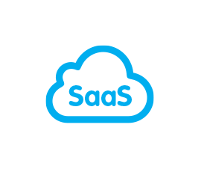
Building Blocks of Cloud Computing:
SaaS (Software as a Service)
Allows users to run existing online applications
This is the easiest way to cloud compute, and is where off-the-shelf applications are accessed over the internet.
Google Docs
Microsoft Office Web Apps
Zoho
SaaS Pros & Cons
Free or paid via subscription
Accessible from any computer on the internet
Excellent for collaborative working
Generic applications not always suitable for business use

Slide 6
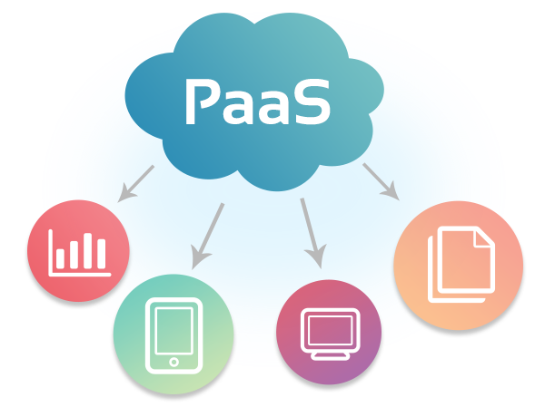
Building Blocks of Cloud Computing:
PaaS (Platform as a Service)
Allows users to create their own cloud applications using supplier-specific tools and language
Provides environment and set of tools for creating new online applications
Google App Engine (Enables anybody to develop and run maintainable web applications on Googles web infrastructures)
(building and hosting the application is free
Microsoft Azure Platform (Allows users to develop and run windows applications in Microsoft region of the cloud)
Salesforcce (building and hosting the application is free)
PaaS Pros & Cons
Rapid development at low cost
These application are deployed privately or publicly
Limits developers to provides languages and tools that PaaS providers have offered
Risk of vendor lock-in

Slide 7
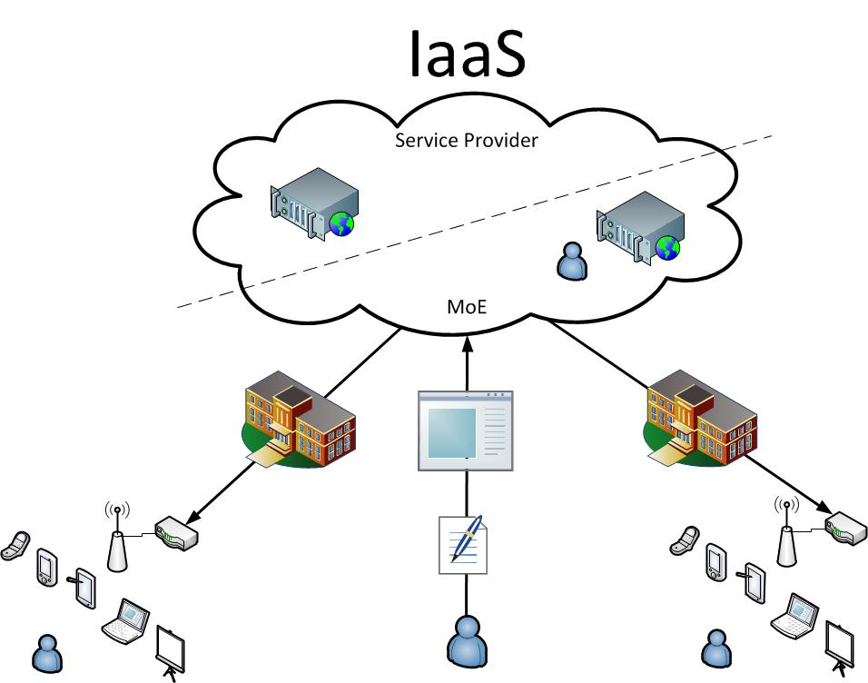
Building Blocks of Cloud Computing:
IaaS (Infrastructure as a Service)
Allows users to run any applications they please on cloud hardware of their own choice
Allows existing applications to be run on a cloud supplier’s hardware
This allows the existing applications can be migrated from a company data centre to IaaS environment in order to reduce IT costs

Slide 8

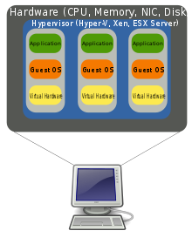
The Cloud Fundamental Unit of Cloud Infrastructure
The Cloud Fundamental Unit of Cloud Infrastructure is the server. Today, the servers could be either physical, or virtual.
Physical Servers: Individual discrete individual computers
Virtual Servers (or Virtual Server Instances): Software control slices of real physical servers. This virtualization allows many users to share one physical server.

Slide 9
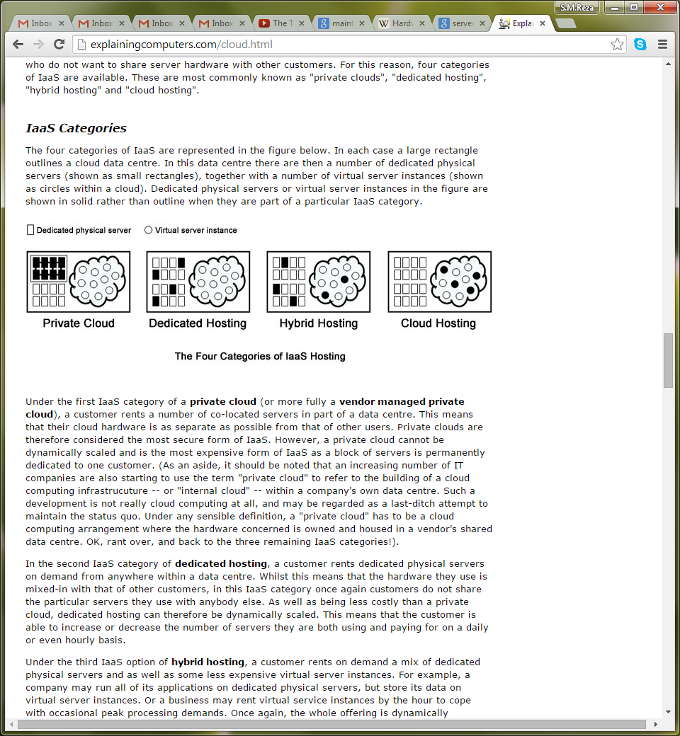
IaaS Categories:
Based on the servers which are used and the services that involved, IaaS Categories are classified into four different hosting levels
Private Cloud
The most secure and costly option: In this architecture, a number of physical servers are dedicated to one customer.
Dedicated Hosting
In this architecture, customers rent physical servers on demand, In order to match their requirements.
Hybrid Hosting
This architecture is the mix of physical servers and virtual server instances, and they are rented on demand, in an effort to reduce cost and further increase flexibility.
Cloud Hosting
In this architecture the customers rent the virtual instances on demand, mostly on an hourly bases.

Slide 10
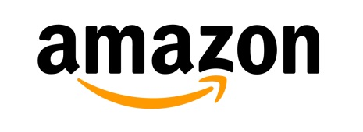
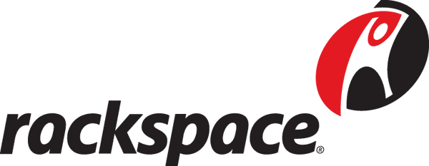
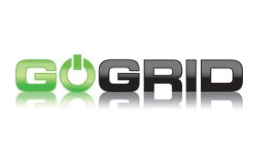
IaaS Companies:
Amazon
Offers a number of Cloud Hosting products which can be rented based on customers’ hourly usage
Rackspace
Offers all four hosting categories
Gogrid
Offers Cloud Hosting, Hybrid Hosting, and Dedicated Hosting solutions.

Slide 11
Today’s Infrastructure as a Service (IaaS) from the Cloud Perspective
Storage Infrastructure: Should be highly available, using Rade and number of other high available technologies
Network Infrastructure: Should be highly available, using multi-link and number of other high available technologies
vCenter Infrastructure: This part is responsible to manage the virtual machines
vCloud Infrastructure : This is to manage Cloud that contains different customers, virtual machines that shape a specific business or function
vApps Infrastructure: This is the way of building the applications whether it is new or a legacy application
In this approach the expectation is the infrastructure should be always available for the applications
The examples for this approach is VMware, Citrix, and many more

Slide 12
OpenStack Infrastructure as a Service
OpenStack is completely open-source and community-based
It is not built-on legacy application, but web applications, BigData applications, and Cloud applications
These are the applications that automatically scale up, or scale down
These applications know how to deal with infrastructures that may not be highly available as we experienced in the traditional Cloud Environments (Designed to fail!)
Some name these new generation applications as “Intelligent Applications” which is really appropriate
OpenStack’s Main Components:
Glance: Name of a project for image repository and keeps track of ISO, and all we need to put together and build an application
Nova: Name of a project that focuses on the compute layer for commodity or any x86 platform to be able to boot, load images and compute functions
SWIFT: Name of a project that supports object-based storage data
Quantum: Name of a project that supports network services in the OpenStack

Slide 13
What is OpenStack?
It is an open-source cloud operating system. Furthermore, it is a community of thousands of people all over the globe.
OpenStack was founded on July of 2010, by Rackspace and NASA. Its mission is to enable any organization regardless of size to create and offer cloud computing servers running on standardized hardware.

Slide 14
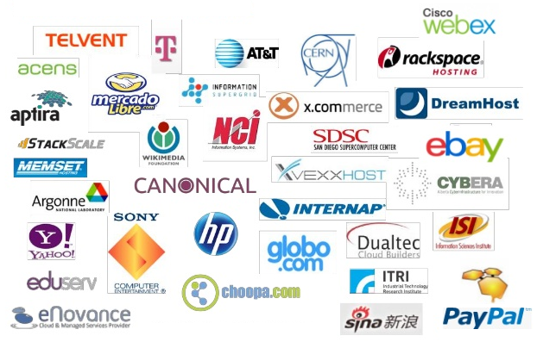
Who supports OpenStack?
In early 2012, the OpenStack had 6700 members in over 83 countries. Developers contribute to different projects with OpenStack primarily in Python, that is freely available under the Apache 2.0 license.
There are some of the teams and technologies that support OpenStack.

Slide 15
What are people doing with OpenStack?
Research Institutions
Government Agencies
Financial Institutions
Biomedical Research Companies
Ecommerce Companies

Slide 16
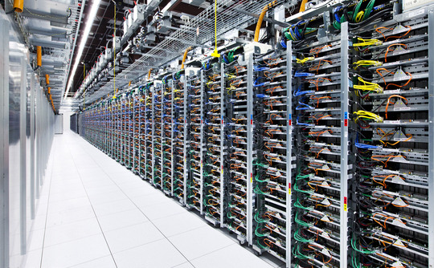
Why Switching to OpenStack?
Companies demands for more resources
For many years developers provide applications and point to them in the dedicated servers.
Adding more applications required more servers, and each server needs more RAM, bigger Hard Drives, and added CPUs. That made a huge amount of troubles for the companies dealing with different servers, include racking, stacking, configuring and networking those servers.

Slide 17
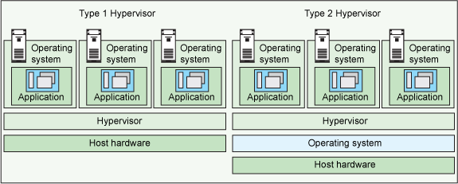
Why Switching to OpenStack?
Hypervisor: The first attempt towards virtualization
In the last decade virtualization came to market to cover some of these problems.
Virtualization added a Hypervisor to the servers that allowed people to access to applications through virtual machines instead of physical machines.

Slide 18
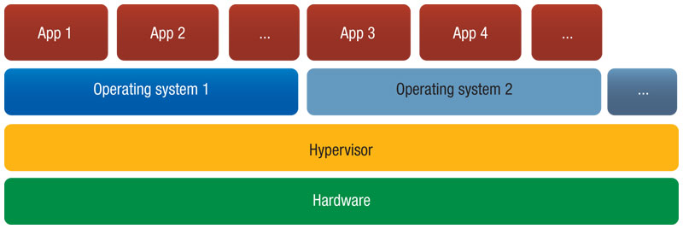
Why Switching to OpenStack?
When does Hypervisor fail?
The Hypervisor works fine up to a certain level, before adding more and more servers which makes it hard for the Hypervisor to manage them. This is a complex situation not only for the administrators, but also for the developers. In this situation both groups cannot get what they need on demand, and there is no ability to automate the routines that they frequently do in this architecture.

Slide 19
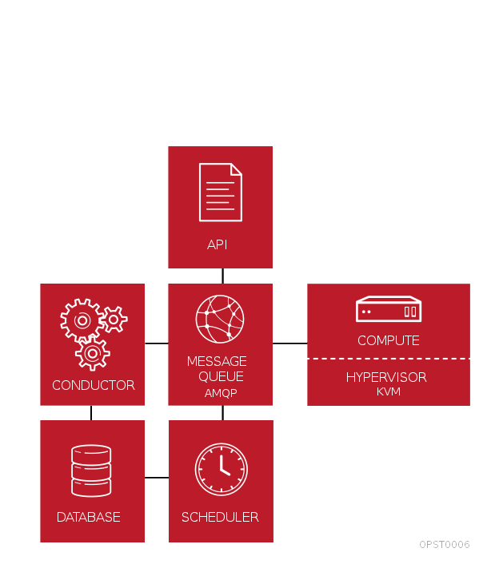
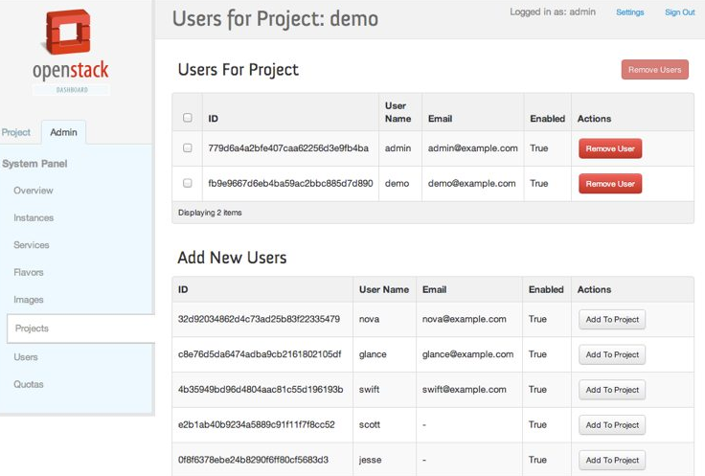
Why Switching to OpenStack?
What OpenStack Does?
OpenStack turns all set of Hypervisors within a datacentre or number of datacentres, providing pools of different resources. Those pools of resources can be managed and consumed from a single place, which is OpenStack. The APIs are available which are programing interfaces, and OpenStack Dashboard provides the ability to manage whatever can be achieved by OpenStack through a visual interface.
From another perspective we can say, OpenStack is a controller above all the virtual resources that are already available in a datacentre.

Slide 20
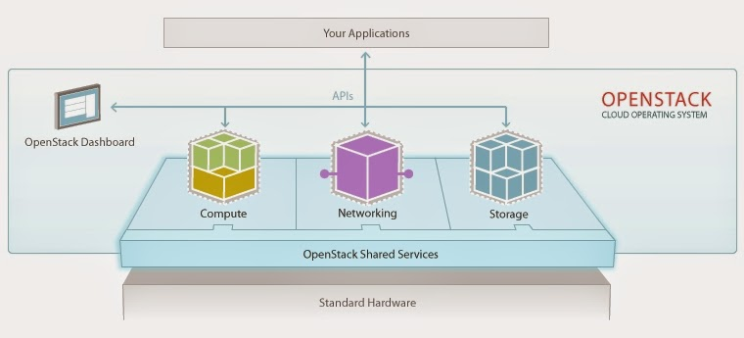
OpenStack’s Components
Nova is a component that controls the compute environment regardless of the Hypervisor that is available. It is possible to run Xen, KVM, Hyper-V, VMware ESX, and many other Hypervisor, and the way to access them is consistent.
The same story is for the block storage in OpenStack which is called Cinder, as well as the object storage which is called SWIFT. For the network, this component is called Quantum.

Slide 21
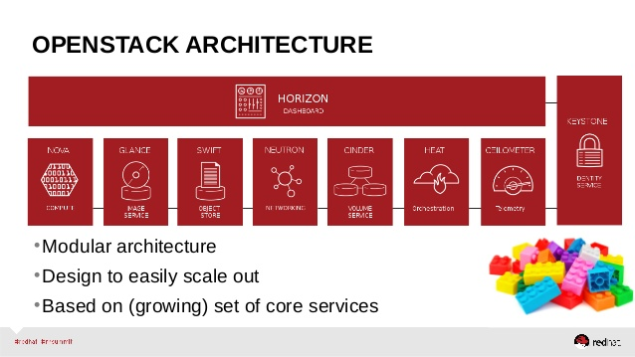
The Complexity in Managing and Consuming Resources
The complexity in managing and consuming resources across the heterogeneous environments and from different vendors and Hypervisors is made much easier.
The idea of OpenStack is to abstract administrators, and users away from the underling components, and allows them to consume those resources as a service, using the consistent set of APIs and a common Dashboard.

Slide 22
Thank you

